Slide 1


Classification challenge
on
Alzheimer’s Disease data
Taiabur RAHMAN

Slide 2

Outline
Data Preprocessing
Feature selection
Data Analysis
Predict data
Predicted Scores
Result

Slide 3
Data Preprocessing
Inspect p the number of predictors and n is number of samples each dataset.
Dataset 1: n = 164, p = 429 => Very high
Dataset 2: n = 172, p = 63 => Low dimensionality
Dataset 3: n = 172, p = 593 => Very high dimensionality

Slide 4
Data Preprocessing
In dataset to classify patients to 2 classes
AD: Alzheimer Disease
CTL: Control
To achieve the result train the following models:
Logistic Regression
Support Vector Machine
Random Forest

Slide 5
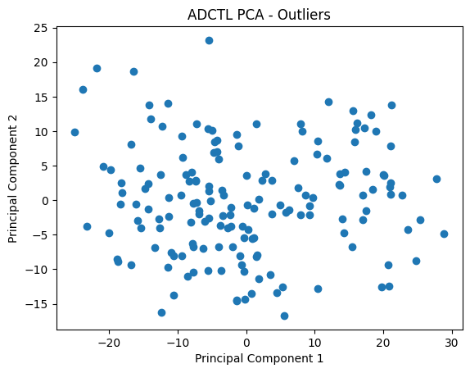
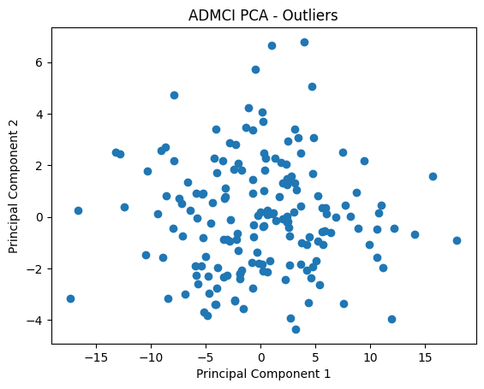
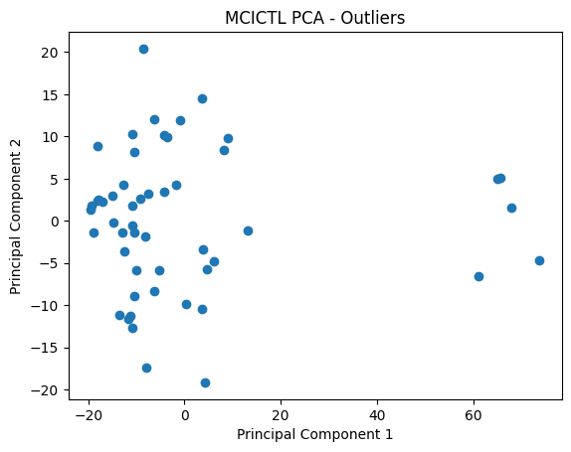
Data Analysis
The first step of the challenge is to analyse the datasets. The result summarised
Principal Component Analysis

Slide 6
Training dataset predicted
Performance on the training datasets
Logistic Regression
 | Accuracy | Sensitivity | Precision | F1 | AUC | MCC | Balanced Accuracy
ADvsCTL | 0.8609 | 0.8889 | 0.8276 | 0.8571 | 0.8625 | 0.7236 | 0.8625
ADvsMCI | 0.7438 | 0.7778 | 0.6885 | 0.7304 | 0.7471 | 0.4914 | 0.7471
MCIvsCTL | 0.7769 | 0.7612 | 0.8226 | 0.7907 | 0.7787 | 0.5544 | 0.7787

Slide 7

Thank you!

